Slide 1



CROP AND FERTILIZER RECOMMENDATION SYSTEM
BY :-Abdul Tarique Warsi

Slide 2

Learning Objectives
The Crop and Fertilizer Recommendation System Focuses on enhancing advanced machine learning technique to analyze soil characteristics, weather conditions, and crop requirements. Through This Project we dive deep into Python Libraries like.
Pandas,Num-py for Data Analysis
Seaborn and MatPlot-Lib for Visualisation
Sklearn for Machine Learning Actions
Main Objective is to feel the the real world Scenarios and problems.
Mainly we come to know how programing works and it broadens our vision about Python.
GOAL

Slide 3




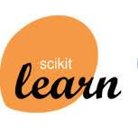



Tools and Technology used
MAIN APPS FOR PROGRAMMING
Machine Learning Concepts:
Dicision Tree
Pre-Processing
Scaling
Prog.Lang:
Python
Gui’s:
VS Code
Jupyter Notebook
Libraries:
Pandas
NumPy
Seaborn
MatplotLib
ScikitLearn
CROP&FERTILIZER RECOMMENDATION SYSTEM
LIBRARIES USED

Slide 4
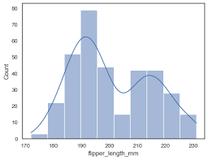
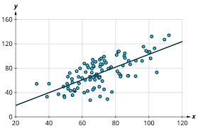
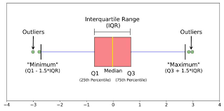
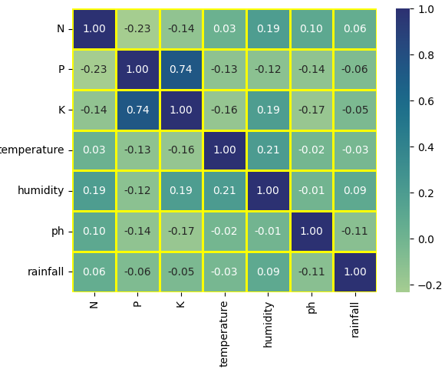
Methodology
Setting of Environment:
Installing Vscode.
Installing python.
Downloading all Libraries in Terminal.
Setting jupyter notebook .
Start Coding.
Cleaning Data:
Importing necessary Libraries.
Loading Data and reading it.
Checking its structure(shape ,column names , data types , rows, describing Aggregate functions like mean etc.).
Checking & Eliminating Null and Duplicate values.
Selectin g Target and Feature From Data
Visualizing Data:
Visualizing HISTPLOTS for Feature Distributins.
Visualizing SCATTERPLOTS for Relation between Target and Features.
Visualizing BOXPLOTS for finding Outliers then Eliminating them.
Visualizing HEATMAP for finding Features correlation with each other.

Slide 5
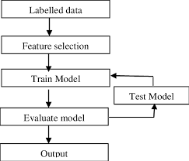
Peparing Data for Machine Learning:
Converting TARGET Values to Unique Numbers to make it easy for Machine learning.
Deleting every string or object column so that only factual data remains.
Machine Learning :
Splitting Data in 80/20 for TRAINING and TESTING.
Modeling of Data.
Scaling of Data.
Training of Data Using Tree like Decision Tree Classifier .
Testing accuracy.
Creating of Prediction Function.
Sample run of Program to ensure working.
Deployment :
Adding some good visibility.
Uploading to desired place like github.

Slide 6
Problem Statement:
Agricultural productivity is a critical factor for ensuring food security, sustainable farming practices, and economic growth. However, many farmers face challenges in selecting the most suitable crops and fertilizers for their specific soil conditions, climate, and available resources.
Traditional farming decisions often rely on guesswork or outdated practices, leading to poor crop yields, soil degradation, and inefficient use of resources .
Key challenges include:
Lack of data-driven decision-making in crop and fertilizer selection.
Inefficient fertilizer usage, causing soil degradation and environmental harm.
Inability to adapt to changing climate conditions and soil health variations.
Limited access to personalized recommendations for small-scale farmers.

Slide 7
Proposed Solution
Crop and Fertilizer Recommendation System.
Our Crop and Fertilizer Recommendation System aims to :
Address these challenges by providing farmers with data-driven, personalized recommendations.
Using advanced technologies like machine learning and data analytics.
The system analyzes various parameters such as soil type, nutrient content, weather conditions to suggest : Optimal crops that can thrive in specific environmental and soil conditions
Using These we aim to provide :
Appropriate fertilizers with the right nutrient composition, reducing waste and environmental impact.
Sustainable farming practices to enhance soil health and long-term productivity.
This system helps farmers make informed decisions, improving crop yields, reducing costs, and promoting sustainable agriculture practices.

Slide 8
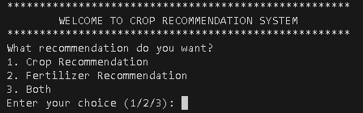
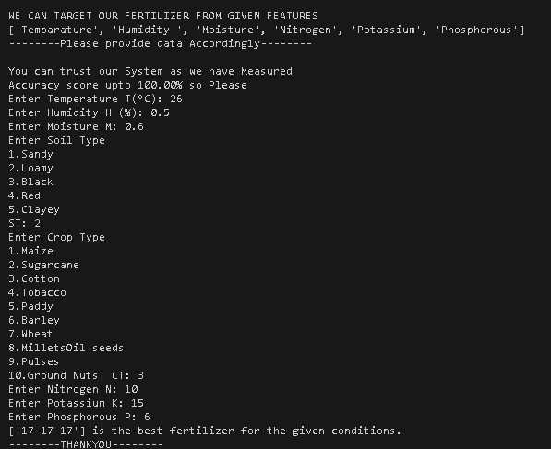
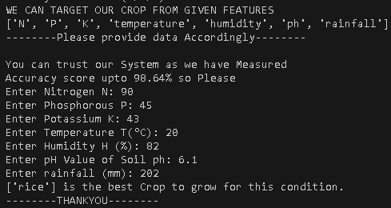
Screenshots of CFR SYSTEM
Main Menu
Crop Recommendation
Fertilizer Recommendation

Slide 9
CONCLUSION
The Crop and Fertilizer Recommendation System aims to enhance agricultural productivity through data-driven, personalized recommendations. By leveraging advanced machine learning techniques, the system analyzes soil characteristics, weather conditions, and crop requirements to assist farmers in making informed decisions.
Objective:
Improve agricultural practices with data analytics and machine learning.
Address real-world farming challenges like inefficient fertilizer usage and poor crop selection.
Methodology:
Data cleaning, visualization (using histograms, scatterplots, boxplots, heatmaps), and model training with Decision Tree Classifier.
Focus on accurate predictions through data preprocessing and scaling.
Technologies Used:
Python for programming, with libraries like Pandas, NumPy, Seaborn, Matplotlib, and Scikit-learn for analysis and modeling.
Impact:
Promotes sustainable farming by reducing guesswork and improving resource efficiency.
Provides personalized crop and fertilizer recommendations, boosting crop yields and minimizing environmental degradation.
Deployment:
User-friendly interface with crop and fertilizer recommendation modules.
Easily deployable and shareable through platforms like GitHub.
6.Final Thoughts:
The project not only demonstrates technical proficiency in Python and machine learning but also offers a practical solution to real-world agricultural problems. It highlights the potential of technology in driving sustainable agriculture, optimizing resource use, and supporting farmers with actionable insights.

